Slide 1


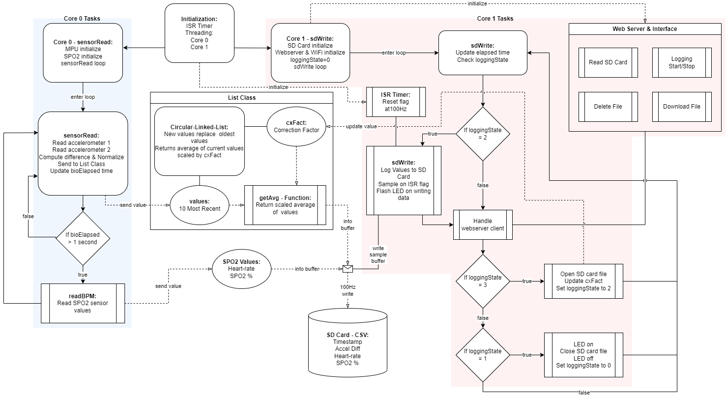
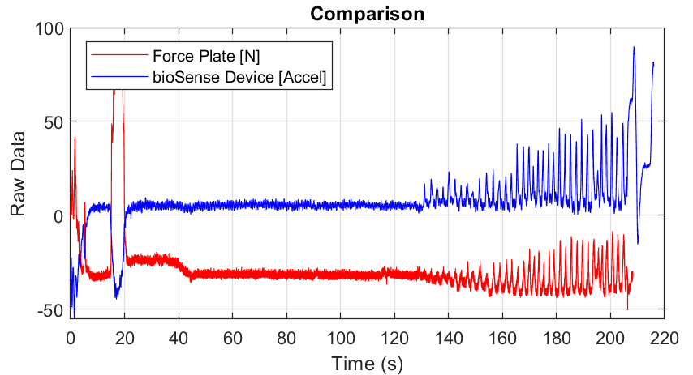
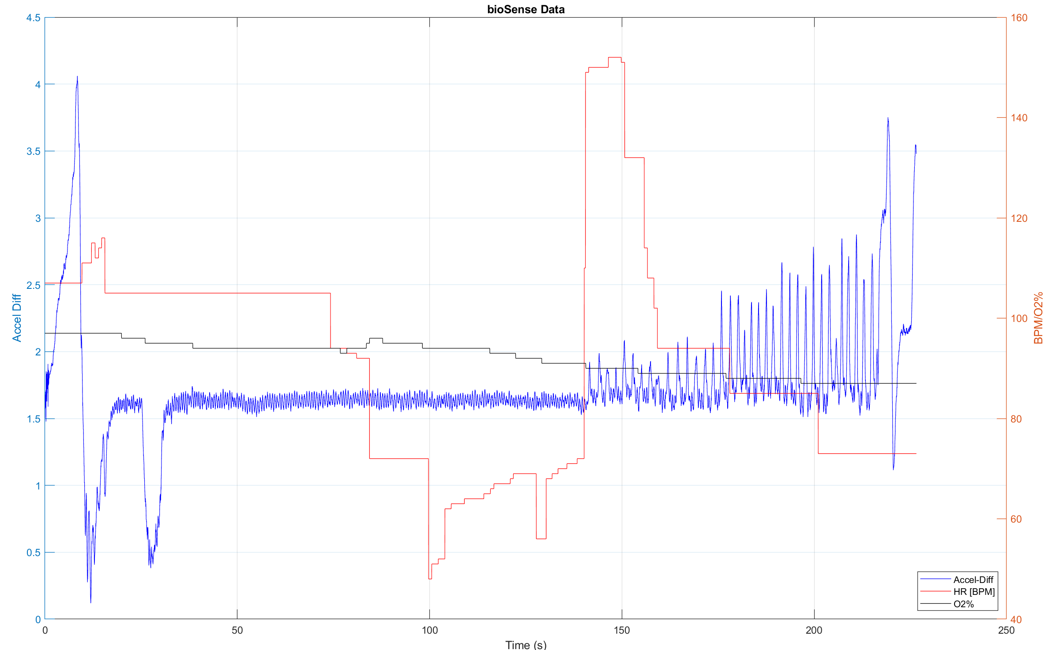
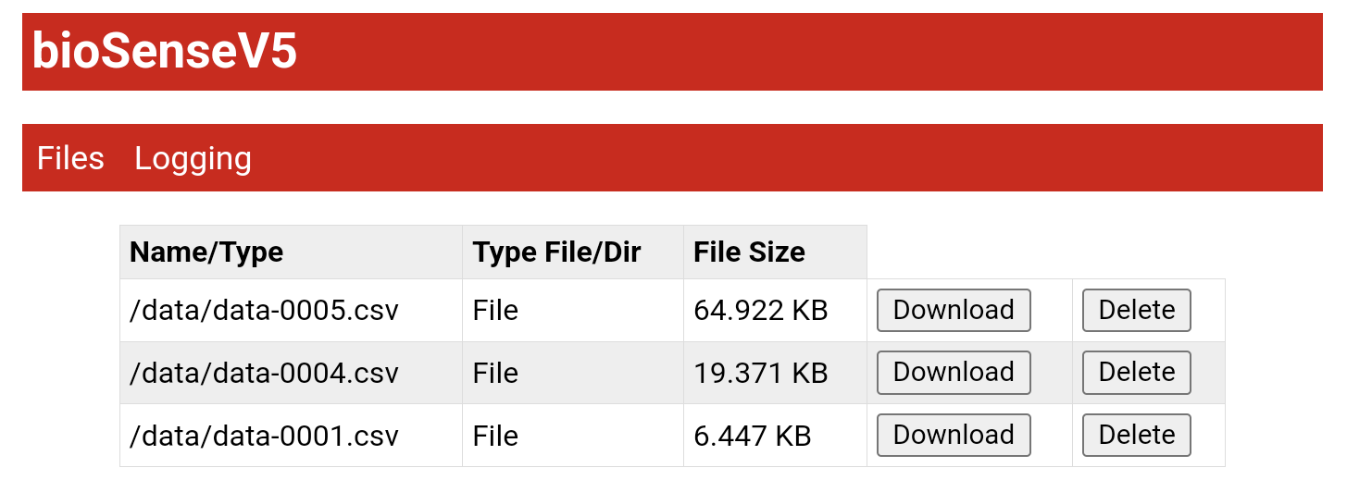
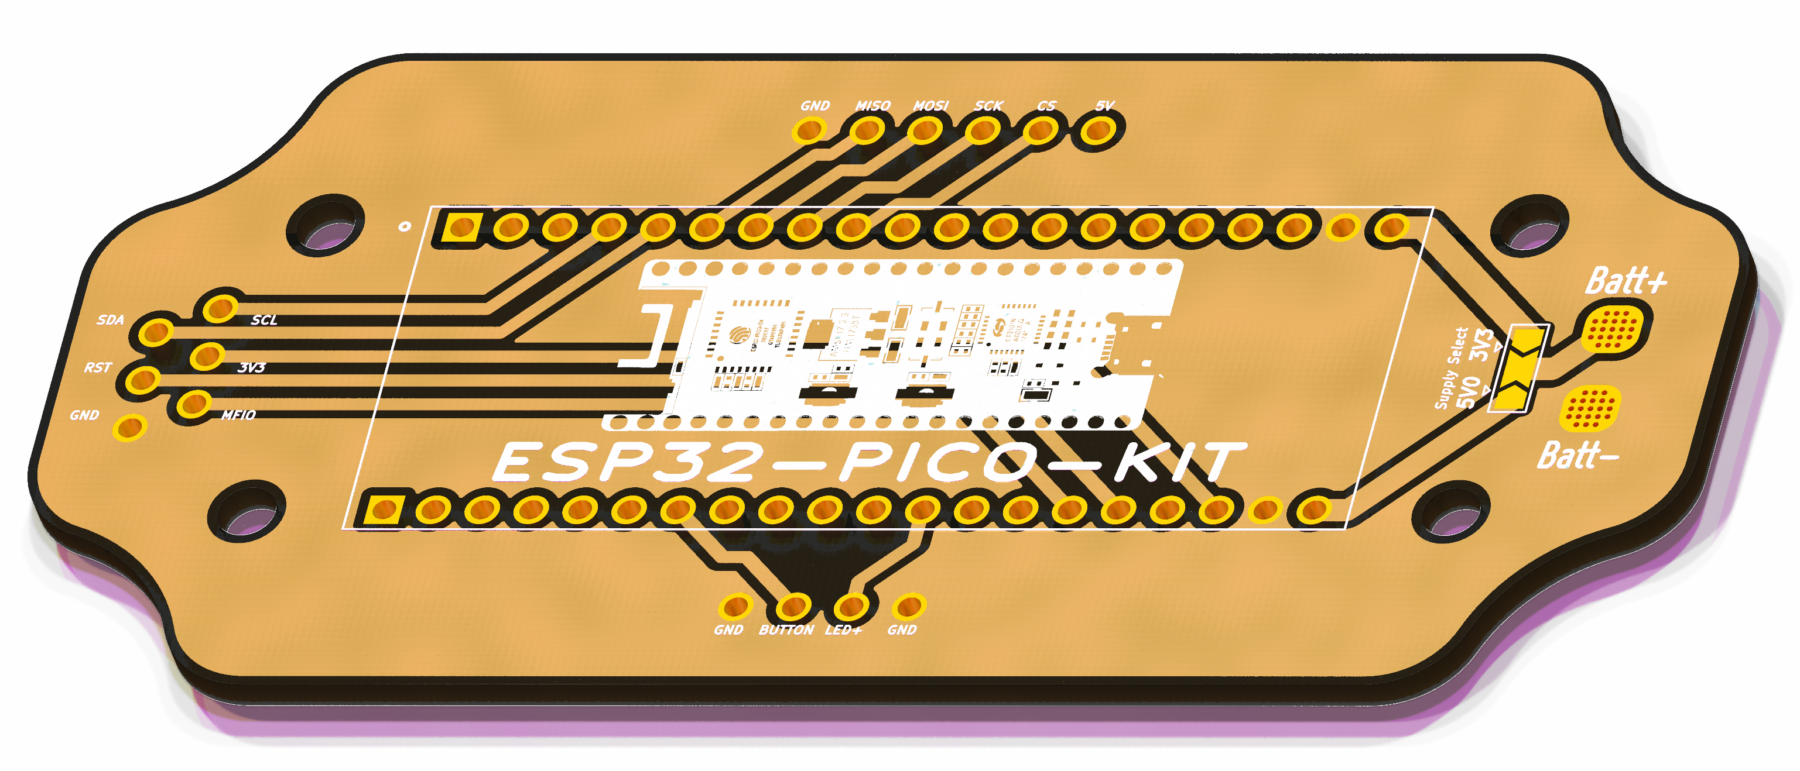
Differential Measurement of Involuntary Breathing Movements
Jacob Seman and Lillian Tucker
¹ Colorado Mesa University
PROBLEM STATEMENT
RESULTS AND DISCUSSION
To design a device that can monitor and record amplitude and frequency of involuntary breathing movements (IBM) in prolonged breath holds.
Designed specifically for a kinesiology research project in collaboration with the Montford Family Human Performance Lab at Colorado Mesa University.
The differential accelerometer data was observed to be consistent, with minimal filtering or averaging needed to observe pronounced IBM peaks at the onset of the physiological response. The IBM peaks persist even while the subject may undergo posture changes during the extended breath hold.
Note that the force plate data was subject to shifts and trends, while accelerometer difference data remained at a consistent baseline level, allowing easier peak detection.
The pulse oximeter sensor was noted to occasionally drop out and report null data for heart rate and blood-oxygen percentage (Fig. 3). This sensor was sensitive to pressure when attached to a subject’s fingertip and required careful attention during placement.
The device consumes 185mA in all states, and when powered from a lithium 9V battery it has a runtime of 3.5 hours. The webserver interface is easy to use and understand (Fig. 5).
CRITICAL DESIGN
A GRAPHICAL REPRESENTATION OF YOUR DESIGN GOES HERE
Differential measurement of the xiphoid process and sternum using digital accelerometers on a single axis
Measurement of blood oxygen and heart rate
Remote logging, recording, and downloading of data
User friendliness, smart device compatibility
DESIGN EVALUATION
Figure 4. Data comparison of sensor (blue) & force plate (red).
The design was assessed for comfort and ease of use in subject testing. Data output was compared against the existing method for observing IBMs through a force plate (Fig. 4). Collected data was observed to match force plate data, with the additional benefits of reduced cost, posture change rejection, portability, increased accessibility, and ease of use. The sensors were observed to retain accuracy above multiple layers of clothing.
Core threading was used to separate program tasks between the two cores available on the ESP32 Pico microcontroller and achieve consistent data rates (Fig. 2). Logging data at 100 Hz was achieved and could be configured for greater rates if necessary.
A printed-circuit-board (Fig. 1) was designed and fabricated to simplify assembly into a compact, portable enclosure. It included provision for voltage selection.
Data logging was able to be initiated and completed remotely by accessing the device’s webserver (Fig. 5) via a WiFi capable smart device. A laptop was used to download the data log directly from the device’s webserver, where MS Excel or Matlab may be used to parse and interpret the data for research.
Figure 2. Programming block diagram showing separate threads.
Beginning of struggle phase & IBM onset
Figure 5. Webserver interface showing data file management.
CONCLUSIONS AND NEXT STEPS
The device was able to provide data approaching or exceeding the quality of the force plate at a miniscule fraction of the cost and may be used anywhere. The measurement technique is posture agnostic and non-invasive. Remote start, stop, and data download via the webserver is accessible and convenient.
The project will continue with peak detection algorithm development, improvement of the webserver design & user experience, as well as pursuit of journal publication on the topic of the measurement technique.
Figure 1. PCB design render.
Initial postural adjustments
Figure 3. Data output plot showing accelerometer difference (blue) heart rate (red) & oxygen percent (black).
Human data collected with this project was approved by CMU IRB protocol number 22-35. We also thank Dr. Gannon White, Jordan Fleury, and Dr. Michelle Mellenthin for their contributions and involvement in this project.
Notes:
This is a mix between the traditional poster format and the #betterposter format. A title is still present, the intro/methods/results are detailed, but the take-away and graphics are front and center to command the most attention.
Recommendations:
In Powerpoint, click View > Guides
Keep text within gutter guides.
Author list: Don’t split names onto two lines (e.g., “Jimmy [break] Smith”). If that happens, use a new line, unless you need the space. Bold the first names of anybody who’s presenting in person.
Intro/methods/result: Do not drop below font size 28, but if you have extra space, jack up the font size until the space is full.
Do not use color in the sidebars except in graphs/figures. It’ll pull attention from the center and slow interpretation for passersby.

